Slide 1
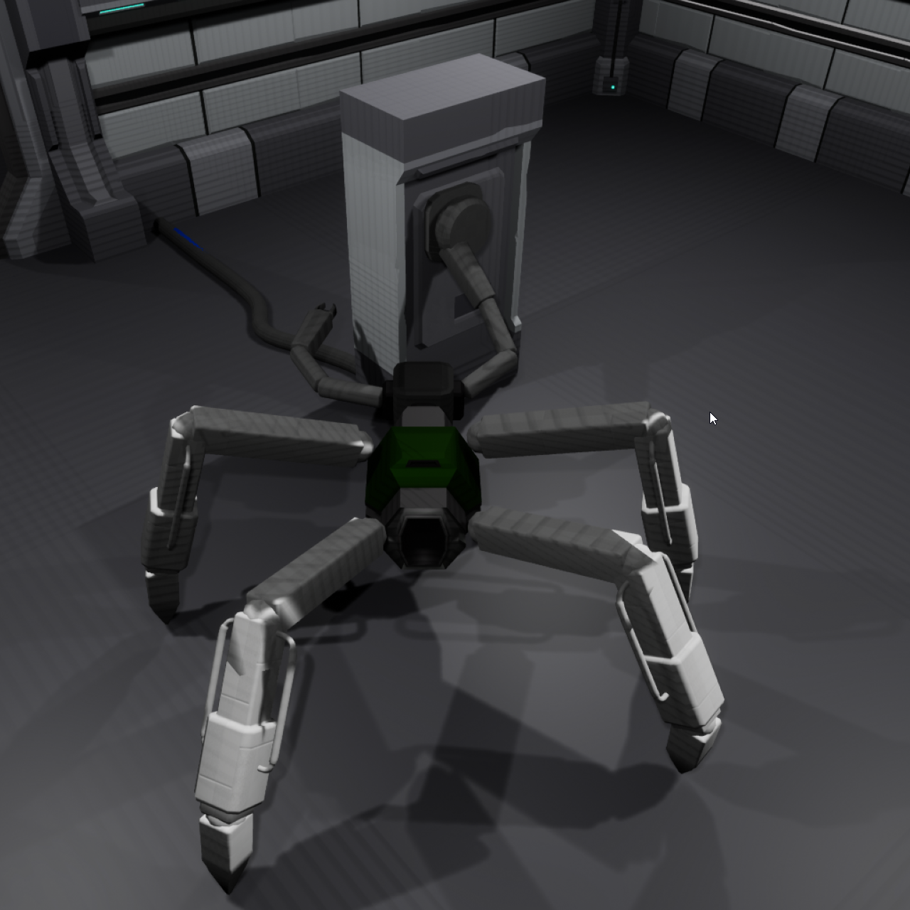
Animatronics – What is it?
Animatronics is a character creation suite, with a vertical slice of puzzle gameplay which involves interaction with various gameplay objects using a created robot.
Users can use the runtime editor to create a robot of their choosing from the parts available, and enter a play-mode state to move the robot around and interact with puzzles.
These robots are entirely procedurally animated, with zero keyframes being used in the project.

Slide 2
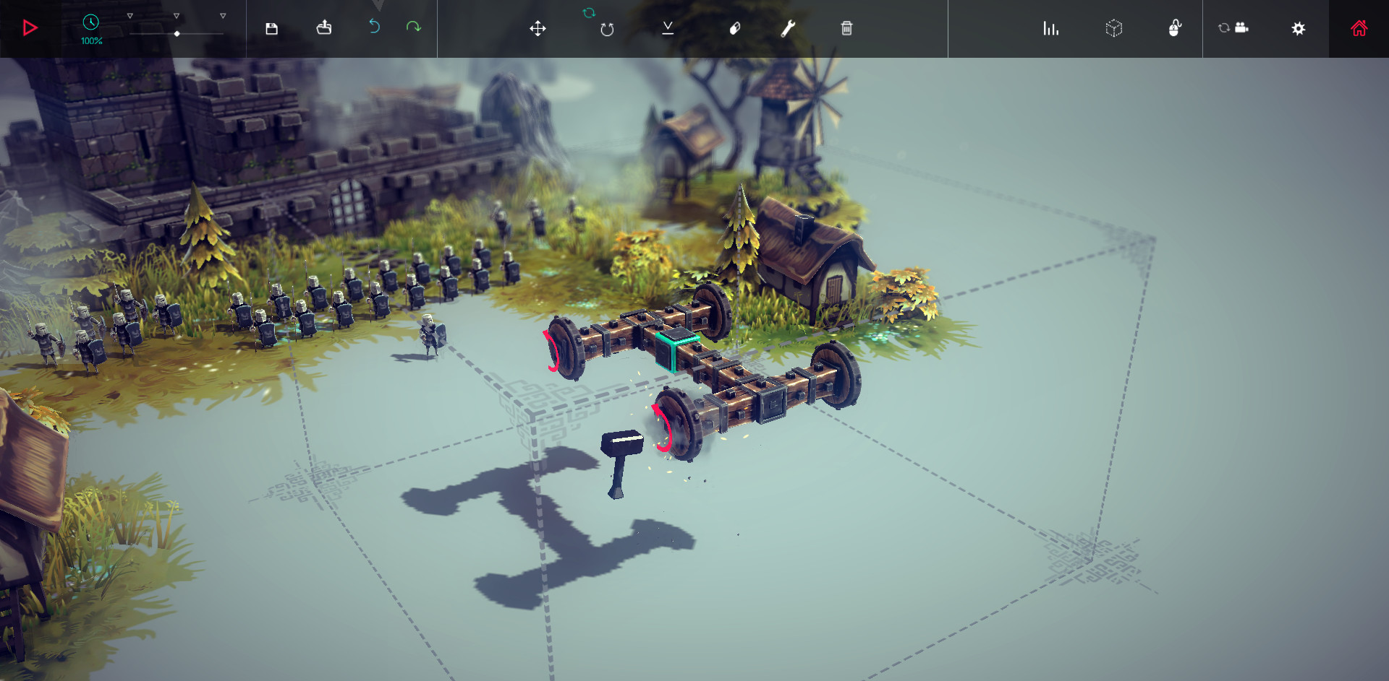
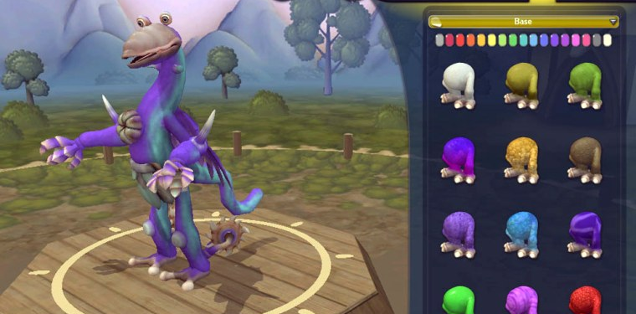
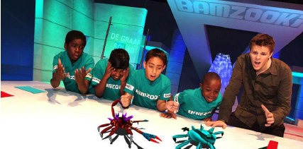
Project Overview – Inspirations
Before settling on a core goal for the project, I spent some time using editors and games which had similar systems to what I had in mind for animatronics
Spore, by Maxis, was a big inspiration for the project
Spore utilises an intuitive creature creation system to make the player’s character
The creature begins as a base torso, with parts being dragged and dropped on to it
The base torso/body can be procedurally modified by selecting points along the body and manipulating their size & position
Parts added to the body include arms, legs, a head, and various other unique modifications
The player can customize the colour of their creature
Creatures can be saved and loaded for use in another game session, or shared with others

Slide 3
Project Overview
Using the analysis of spore as a base, I created an early prototype of editor functionality after writing my project proposal
The goal of this test was to see if procedurally generating a base for the robot could be viable during runtime.

Slide 4
First prototype
Using the runtime procedural mesh component plugin from the Epic store, I created a system which allows manipulation of a cube mesh at runtime
This approach presented a few issues however
Saving robots which utilised this approach would be challenging
Finding a suitable UX/interface for editing the length of parts posed some challenges
The plugin I’d chosen to use for runtime mesh generation caused crashes that were difficult to reproduce consistently, causing issues with stability
After discussions with my supervisor Stuart, I decided to take a socket-based approach.

Slide 5
Refined prototype
Static/skeletal meshes for each part
Each part has sockets assigned inside the .uasset
When a part is being placed, we find the closest socket to the cursor and orient the placing part to it
‘Non-torso’ parts can be placed anywhere on the robot (limbs, decorative parts)
This approach proved much more viable

Slide 6
Project Proposal – Task breakdown
Task name | Importance(1-5) | Complexity(1-5) | Additional notes
Rigged & skinned parts for robot | 1 | 1 | Done in either blender, or 3ds
Control rig for each robot part | 1 | 5
UMG for adding parts to the robot | 1 | 3
Drag & Drop UMG between the UI, and spawning the actor for each robot part on the robot's body | 1 | 2 | UMG makes the implementation of drag & drop in world space fairly easy, which I'd then just need to spawn the actor at the hit position while respecting the normal of the surface hit
Possesssing the created robots in-game | 1 | 1 | Possess the created robot in game via a controller
Aquiring Robot parts from other asset packs/making myself | 1 | 3 | Asset creation (if required) done inside blender, with 3ds max used if more complex hard surface creation required
Rigging Robot parts | 1 | 3
Importing each robot part to Unreal | 1 | 1.5 | If any issues arise - consult Unreal skeletal mesh import documents (likely issues - duplicate bones, root bone without a zeroed transform, etc)
Researching existing character creators | 1 | 1 | Look at the GDC talks from the developers on Spore, take some notes on their design ambitions, look at other similar editors - Sprocket (developed by a student last year) could be a good point of inspiration for procedural mesh stuff
Saving, and loading existing creature configurations in the editor | 2 | 5 | Unreal has existing features (PlayerState etc) for saving data persistently, but will require quite a lot of custom structs to save the entireity of the creatures data (see technical diagrams for a breakdown of this)
Procedural mesh 'skeletal mesh' solution | 2 | 5 | Involving splicing the created skeletal mesh in the editor into smaller segments, controlling them in a manner similar to how Unreal interprets separate bones in a skeletal mesh
Editing procedural torso mesh at runtime | 2.5 | 5 | Probably the most complex part of the project - allowing the user to sculpt the torso of the robot inside the editor, and then split this into a physically driven body
UMG - Basic art assets for character creation menu | 3 | 1 | Basic art assets to denote each attachable part to the robot - likely just a shot of the meshes for each in-game, or a render inside blender
Interaction system - between arms on the robot an environmental items | 3 | 2 | For the vertical slice of gameplay accompanying the character creator
Basic puzzle/objective design for vertical slice of gameplay | 4 | 1
Additional robot parts/passive components | 5 | 1 | Parts such as physically simulated antannae, small screens which change their display with the environment, scanners that play an ambient sound, etc
Saving each robot as a collection of editable .UASSET files | 5 | 5 | Not sure how I'd approach this at the moment, but using the asset manager to create assets which can be edited in-engine outside of the tools I create could prove useful for exporting them to third party programs
Editor player controller | 1 | 2 | Editor functionality for the player - selecting parts from UMG, panning around the robot, selecting options (save, load, play, etc.)
Gamemode logic | 1 | 1 | Handling the transition between the editor and playspace, and initiating the saving or loading of robots through events
Sounds - placement of parts on the robot, ambient robot sounds, background music, etc | 5 | 1 | Source/make some sounds for different events inside the vertical slice. Definitely inside the polish stage of the project, but could add a lot in UX
Torso type selection - choosing between a small, medium and large robot as a base | 2 | 1

Slide 7
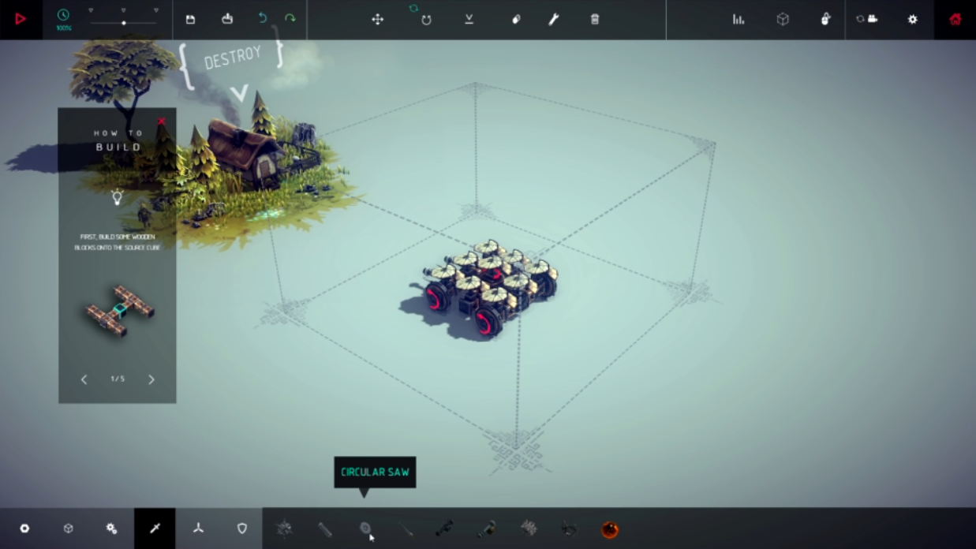
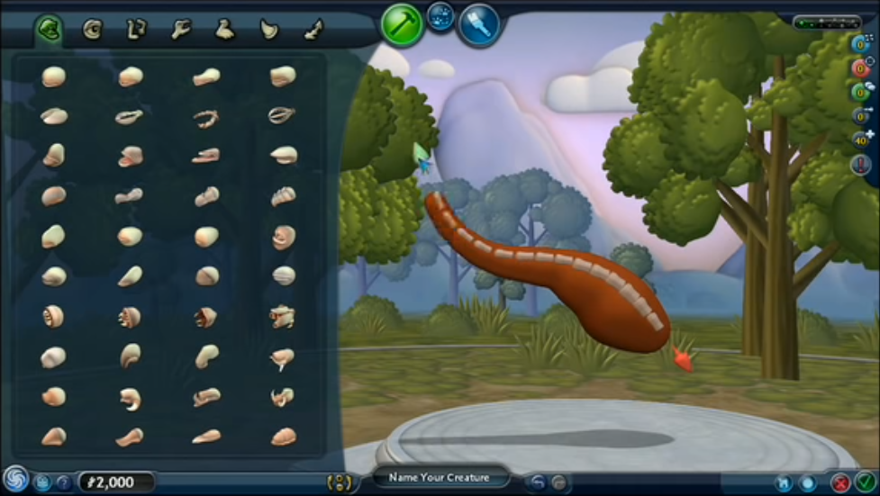
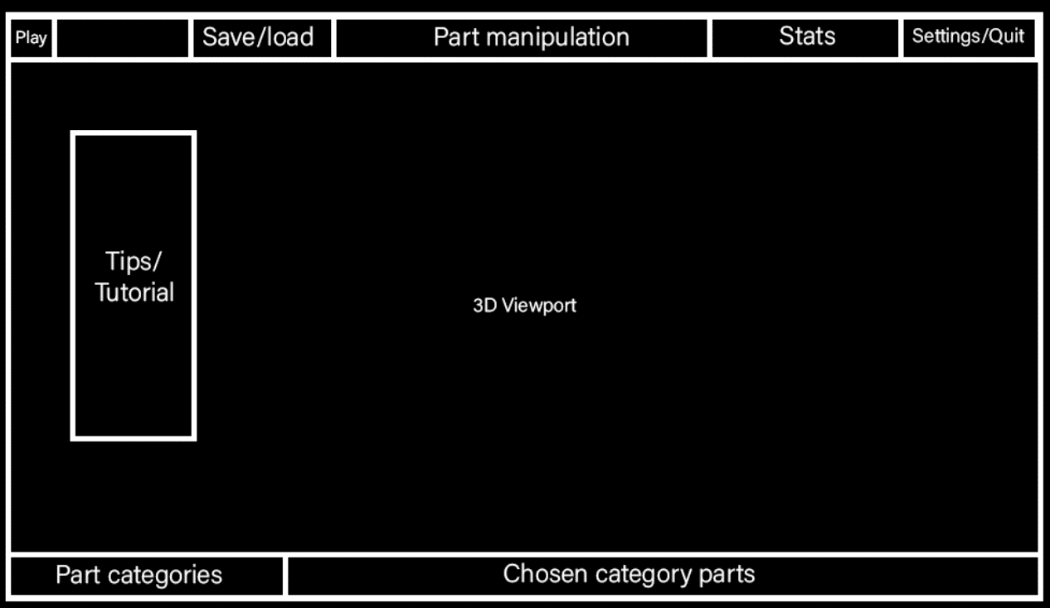
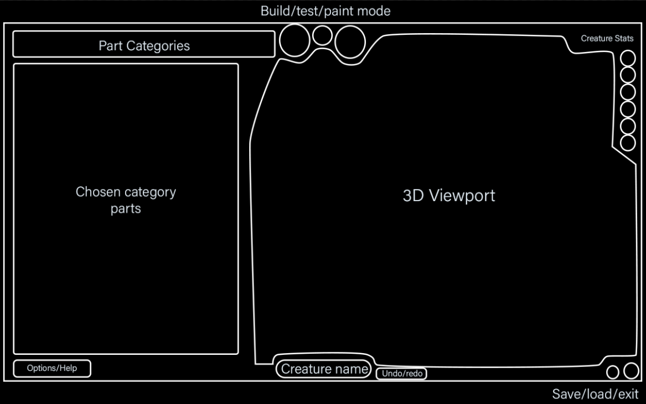

Slide 8
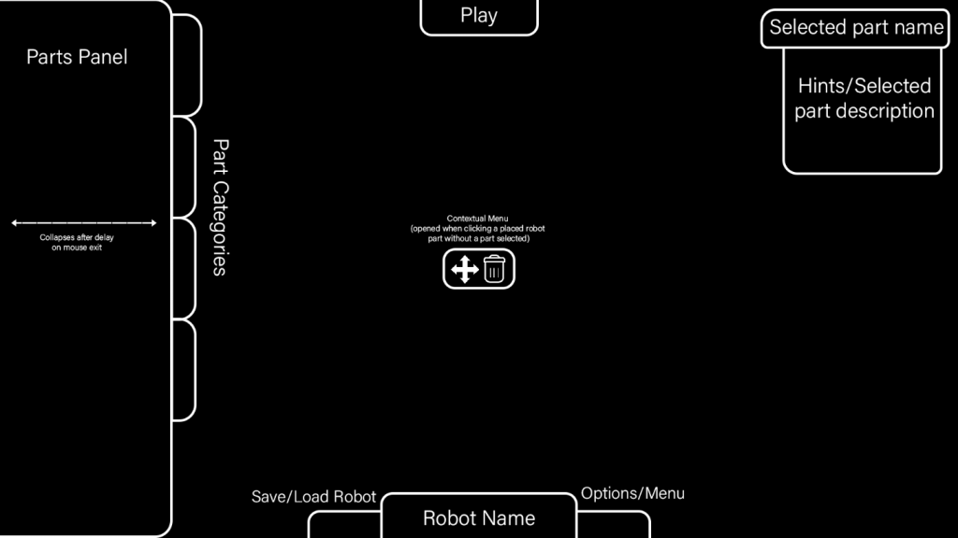
Initial editor wireframe
Initially, this was the wireframe I had created for the editor
It was heavily inspired by both Spore and Kerbal Space Program – two games which organise parts into tabulated categories
This design later changed in terms of the positioning of widgets, but overall remained similar.

Slide 9
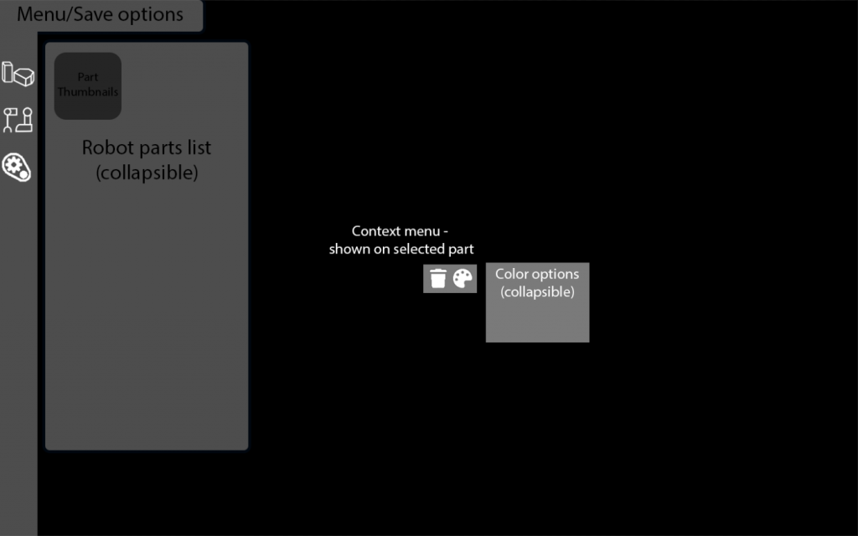
Final Editor wireframe
After the R&D phase, the editor UI was modified to be much more minimalistic
Core editor functionality is now all in the top-left of the viewport, with the collapsible part list keeping its distinct categories but with icons signifying each part type

Slide 10
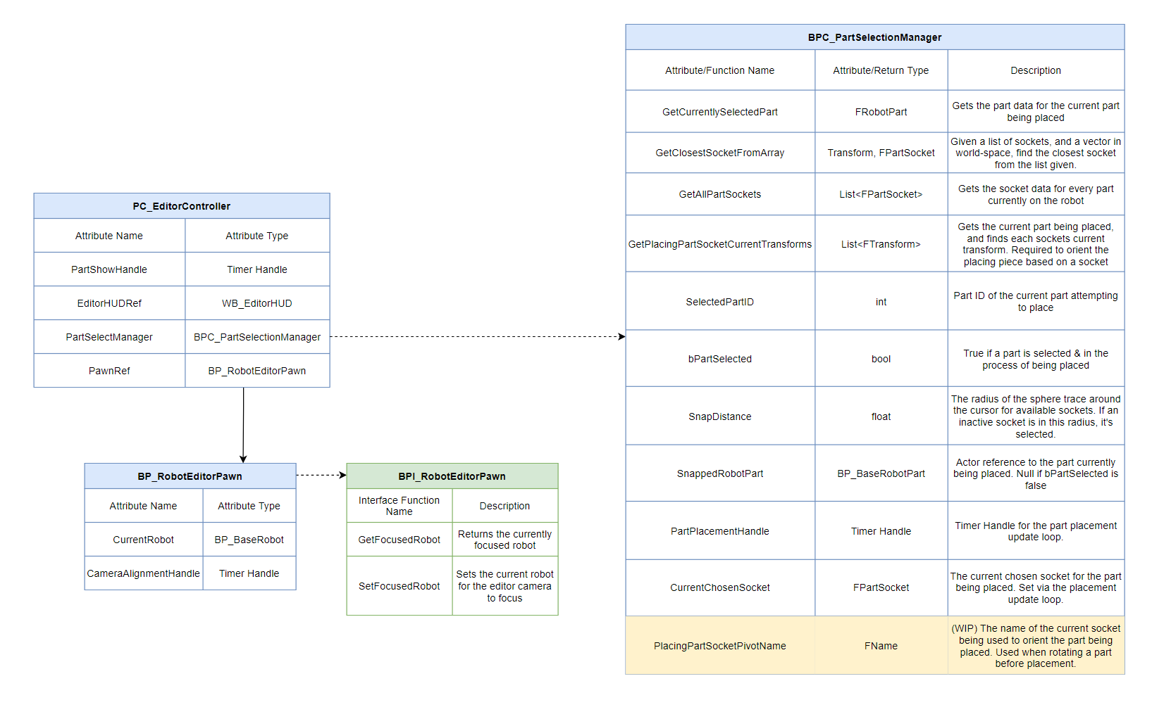
Part selection manager
After the two tests, I knew I’d need an actor component which could drive editor functionality.
I planned the overall structure of this manager in the diagram seen here – doing this ensured that the code for the editor remained well structured

Slide 11
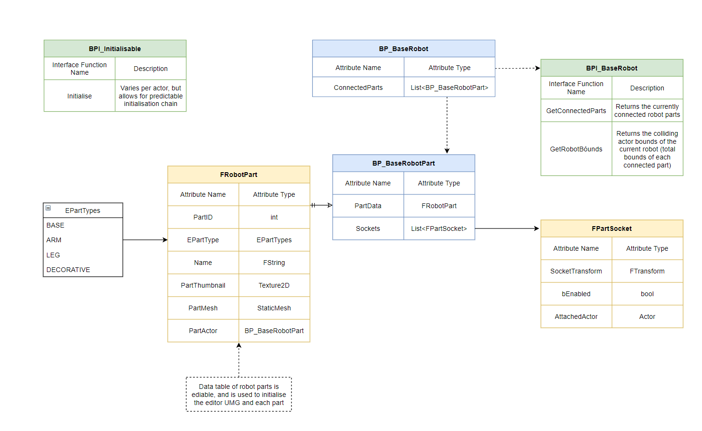
Key data types
A plan was also made for key data types before the R&D phase
Core elements shown here include the FPartSocket, and FRobotPart structures which contain the most of the key information about each part
The FRobotPart structure did have a larger number of attributes by the end of production, but doing this initial planning ensured data flow inside the project was organised

Slide 12
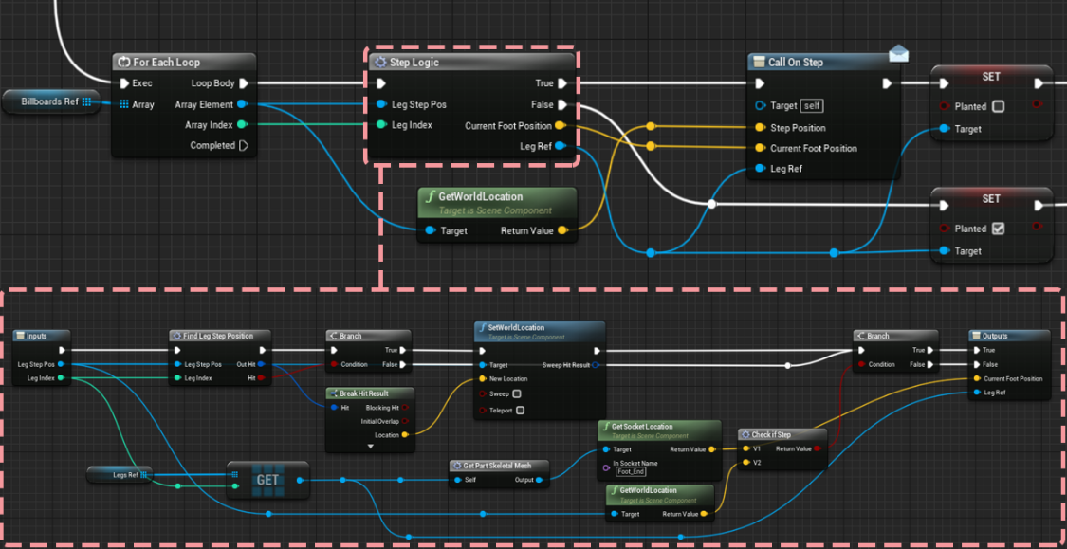
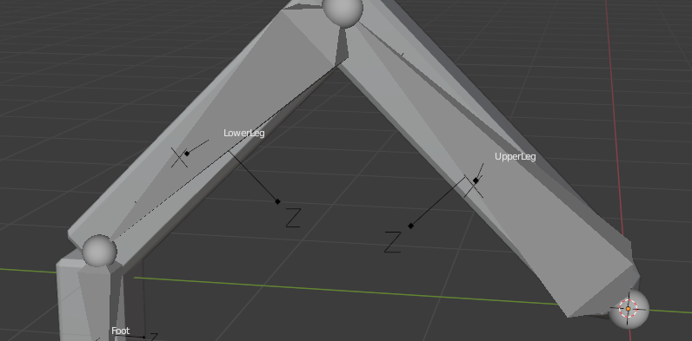
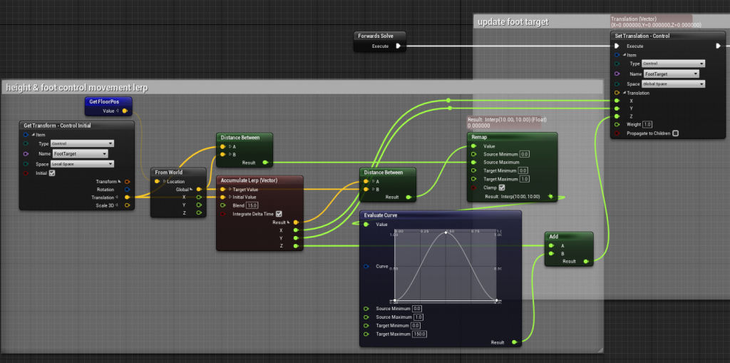
Research and Development – procedural animation
I utilised Unreal Engine’s control rig for the procedural animation of robot parts
By creating actor components on the robot’s pawn which performed traces from each leg currently on the robot, I was able to drive each leg’s animation blueprint with this data and pass it to their control rigs.

Slide 13
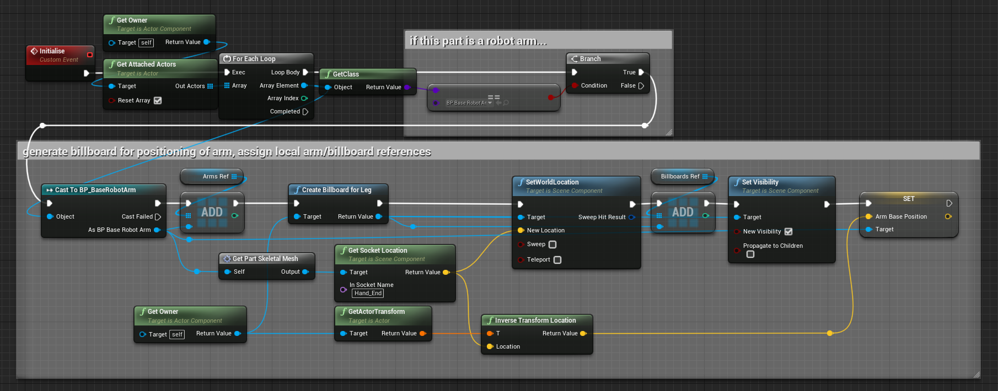
Billboard components were used to cache the previous planted/idle location of each limb.
When the limb is re-planted, the billboard location is set to the new planted location.
To query if a step should take place, the distance between the limb’s current location and the billboard is compared

Slide 14
Procedural Leg Movement

Slide 15
Procedural Leg Movement

Slide 16
Robot limbs in-editor – first pass

Slide 17
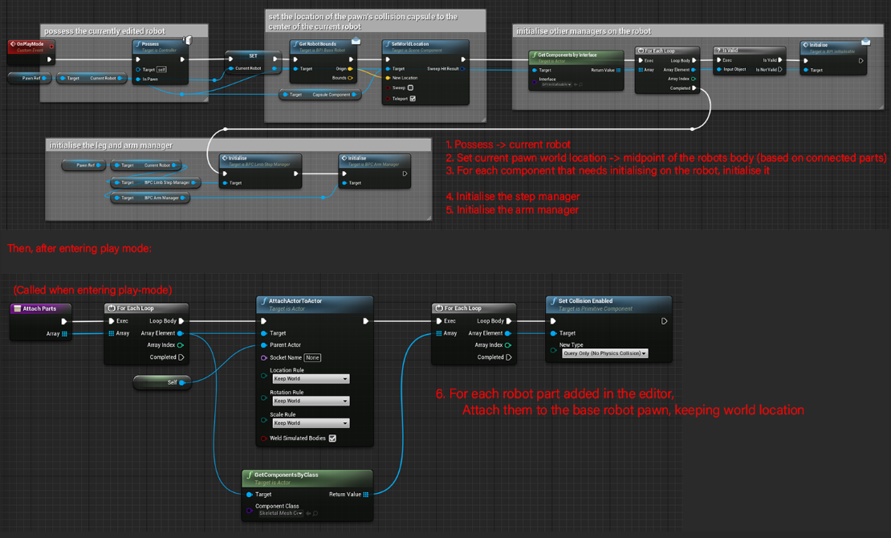
Core framework development – Play-mode functionality
When entering play mode, each part is attached together with an offset based on the socket they’re attached to.
This worked fine for non-torso parts, but posed some issues with core body parts:
The attachment of parts felt very odd when moving around – needed some interpolation on the movement
Parts weren’t simulated, so a physics constraint couldn’t be used

Slide 18
Serialization
Saving robots while inside the editor was a key component of the project goals
During the R&D phase of the project, I confirmed it was possible and created a base framework for saving robots
In later development, this system was refined to save thumbnails of robots, and have a better suited UI to accompany it.

Slide 20
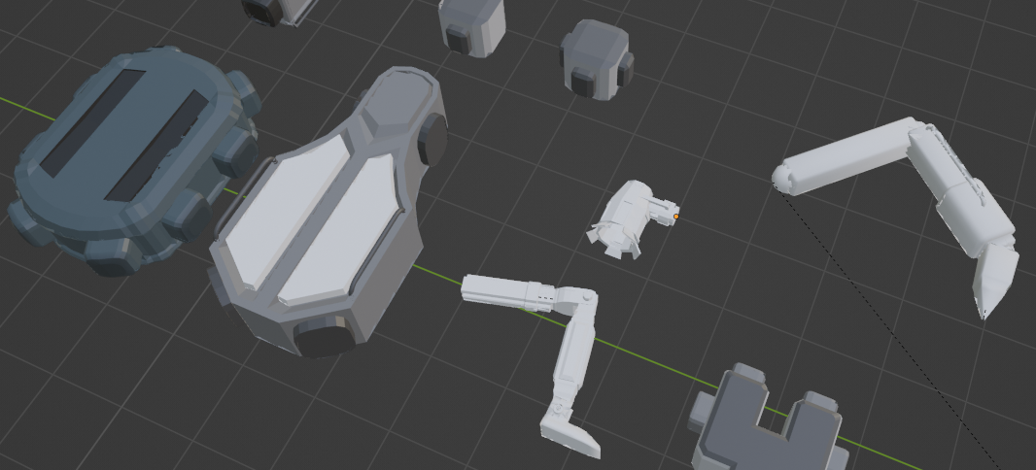
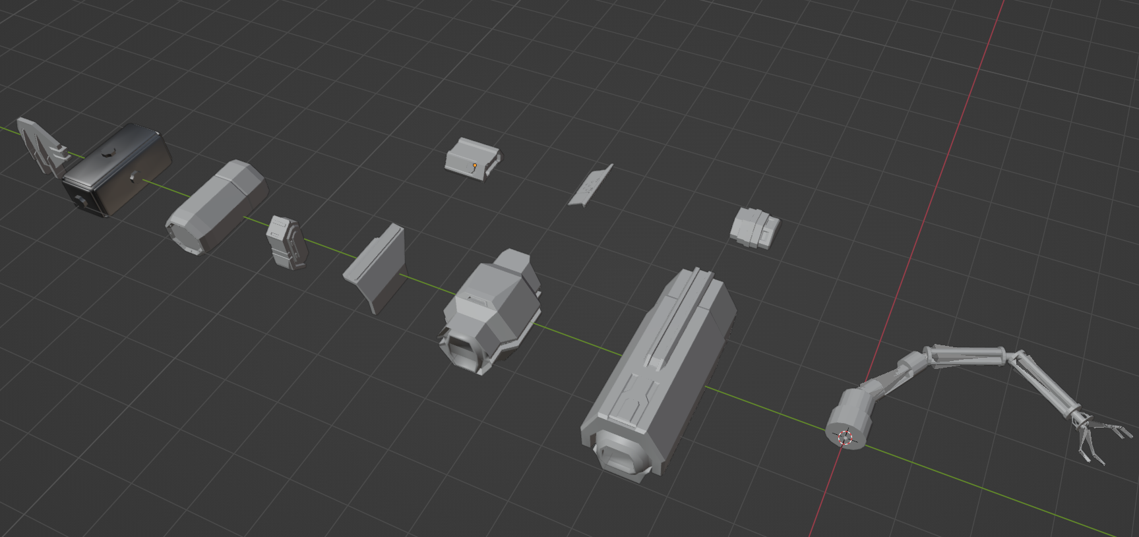
Robot part pipeline
Blender was used to model all of the parts inside the editor, with some segments of parts being sourced from the Synty POLYGON Sci-Fi Space Pack
I used a kitbashing technique when creating the torso parts, by exporting some of the Synty assets into blender and breaking them down into segments I could use
Notes:
Blender – palette UV mapping etc
Blender – rigging, exporting as mesh and importing as skele

Slide 21
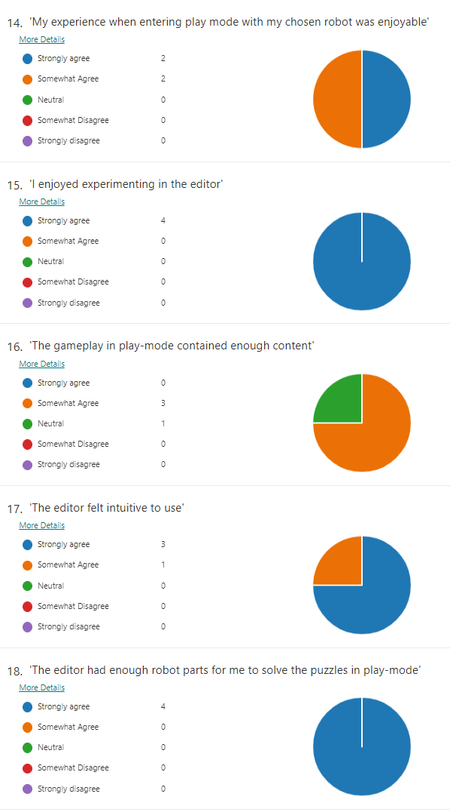
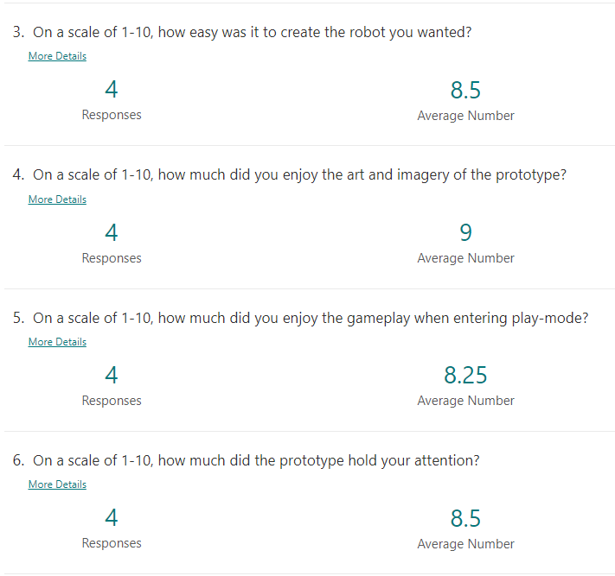
Testing Feedback – Post-R&D
Feedback about the editor was mostly positive
Play-mode would benefit from additional content
Editor help dialogues/a tutorial showing how to make a basic robot would be a valuable addition
More variety in robot parts required

Slide 22
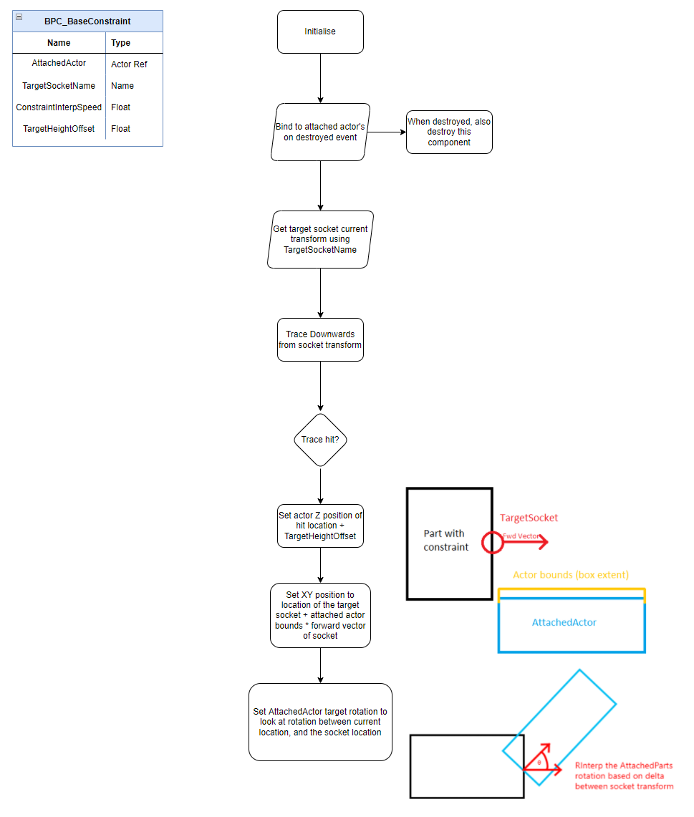
Changes from testing - Custom Constraint Component
After testing an early build with peers, I found that the movement of larger robots felt odd
Parts directly followed each other when rotating and moving forward, and parts hanging from ledges didn’t adjust individually to sit on the surface below them correctly
I looked at the physics constraint component inside Unreal, and had the idea of recreating a similar effect with just interpolation on non-simulated meshes
This became the part constraint component, which is initialised when play mode is entered.

Slide 26
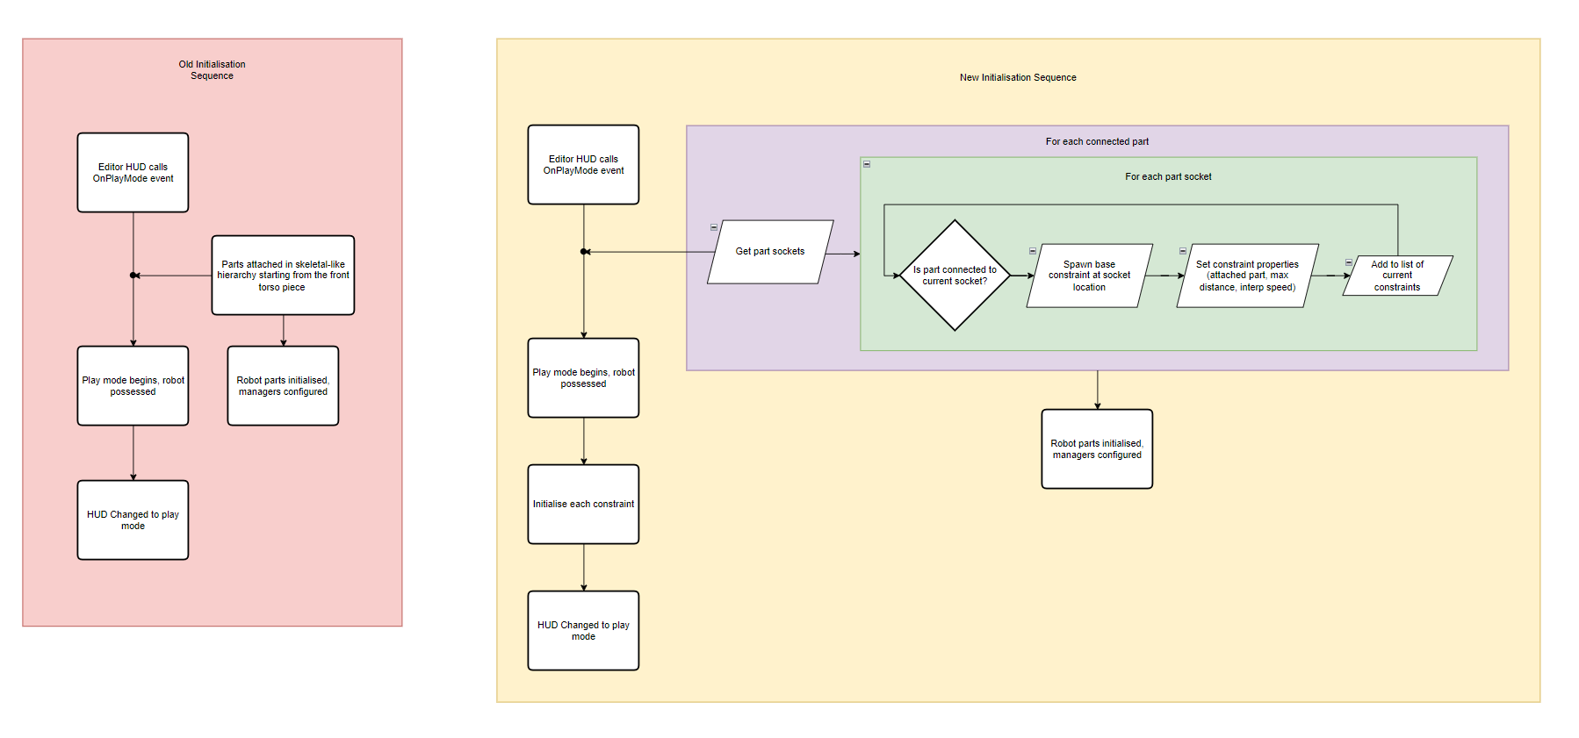
The initialisation sequence when entering play-mode was modified after these changes to spawn constraints between parts that required one
After bringing some peers back for testing following these changes, they preferred how much more dynamic the robot’s movement felt with the new system

Slide 27
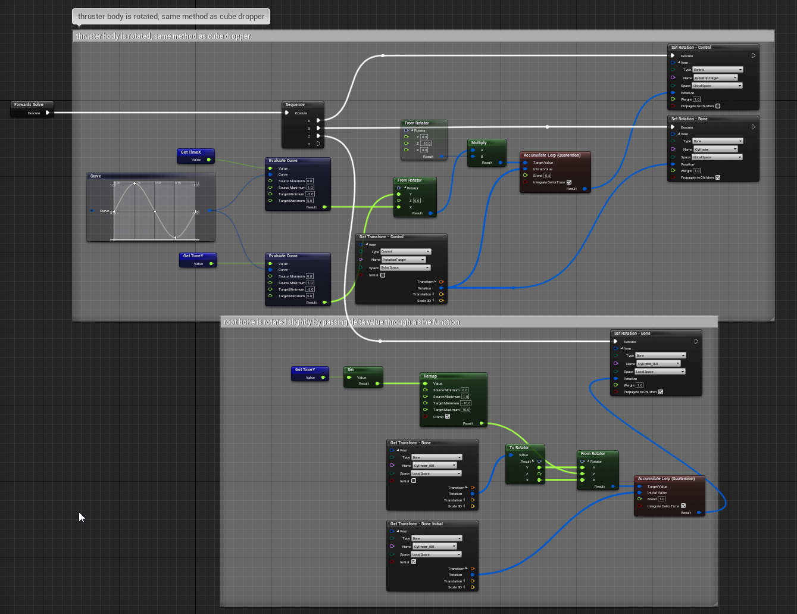
Part variants – Thruster
Around this time, I also experimented with adding in some new limb parts.
Each part required a separate control rig due to the nature of Unreal’s skeletal mesh assets and how they interface with the control rig plugin
The rig graph shown here passively moves the thrusters rotation, to give the impression it’s actively swaying

Slide 28
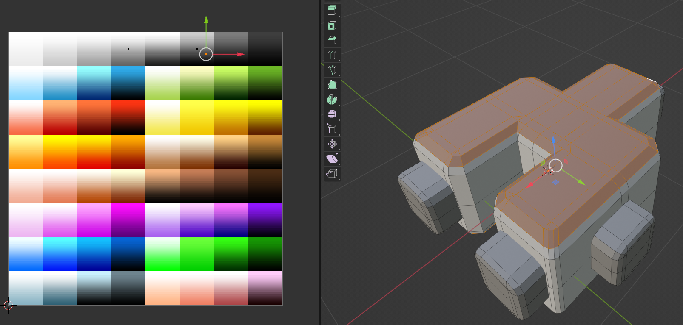
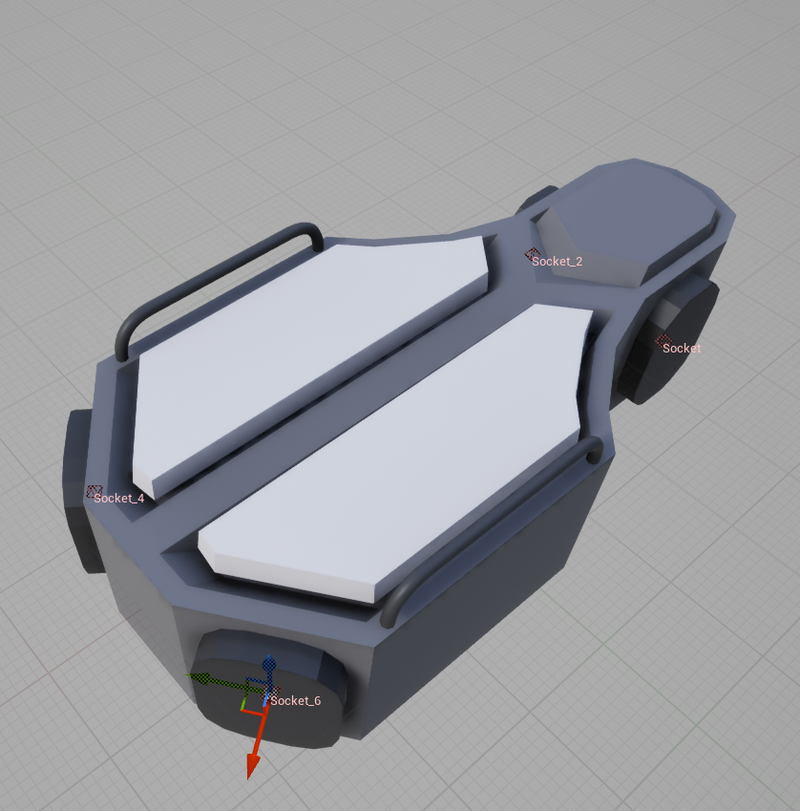
Initially I textured the parts using the conventional method of unwrapping and using Photoshop to create an albedo layer for each mesh
This proved really time consuming, so I searched for another method
I decided to use a UV colouring technique instead to make part production faster
Verts/Faces in the mesh were unwrapped individually and placed at points on the UV palette to designate their colour
I found this technique much quicker than traditional texturing

Slide 29
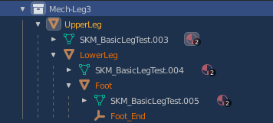
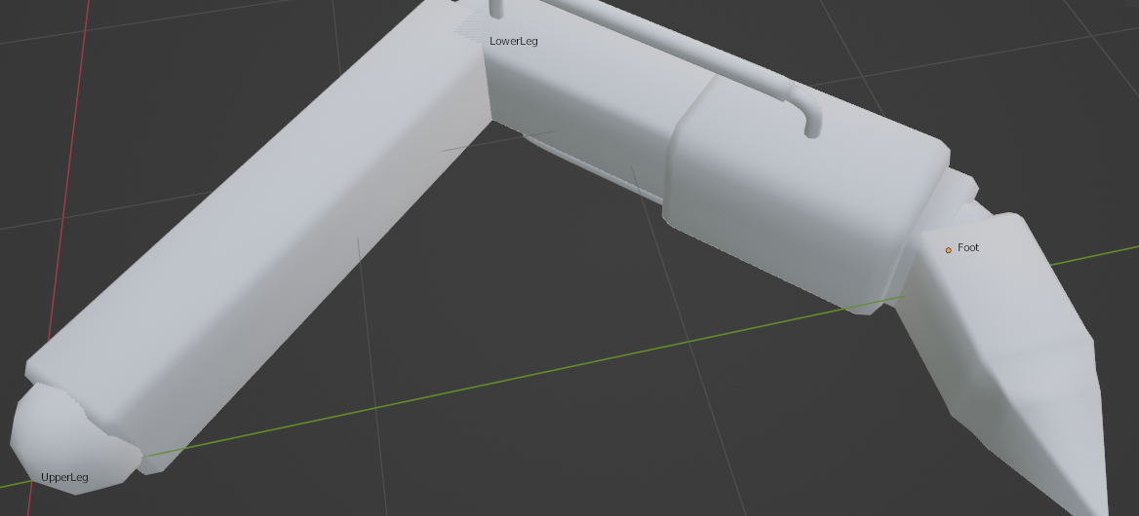
Robot limb pipeline
By parenting each segment to each other as they would be inside a normal bone hierarchy, I could skip the skinning process on less complex limbs
Importing the hierarchical mesh into Unreal and specifying it’s a skeletal mesh made the asset factory identify this hierarchy as a skeleton
As I’m not too familiar with blender and rigging/skinning, this really helped with the modelling pipeline

Slide 30
Final product

